Slide 1
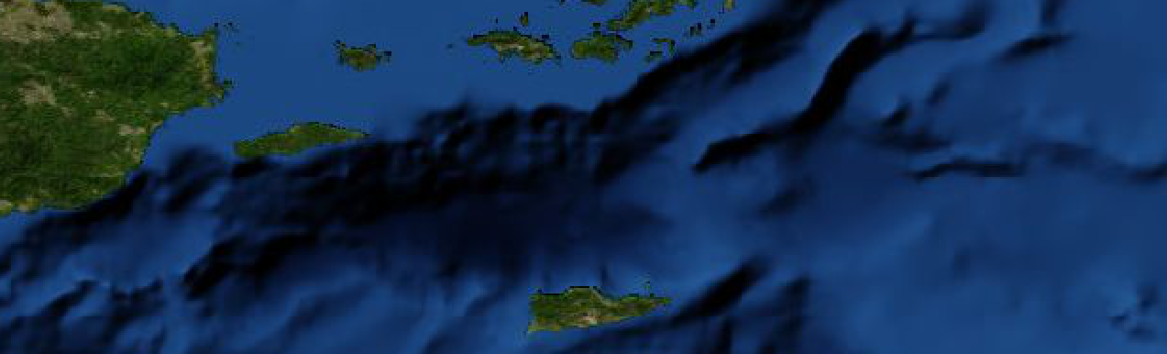
Data Management Needs and Opportunities for Hazard Mitigation Plans
Karl Benedict, PhD
Director of Research Data Services, University Libraries – University of New Mexico
Image Credit: NASA GIBS
Notes:
Good Morning
Thanks to Kim and Greg for invitation: one of the largest data management planning consultations I’ve worked on …
Dr. Colf basically gave my pitch in the last presentation …
Our Process: Conversation to elicit greater understanding of data management needs for …
All Phases of a Disaster: Mitigation, planning, response, recovery
Explicit instead of implicit data management planning
Acquisition
Management
Collaboration
Analysis
Preservation
Discovery & Access
Cost of data integration …
Cost of delivering information to diverse users through different channels

Slide 2



Overview
Needs
Preparation
Outcomes

Slide 3
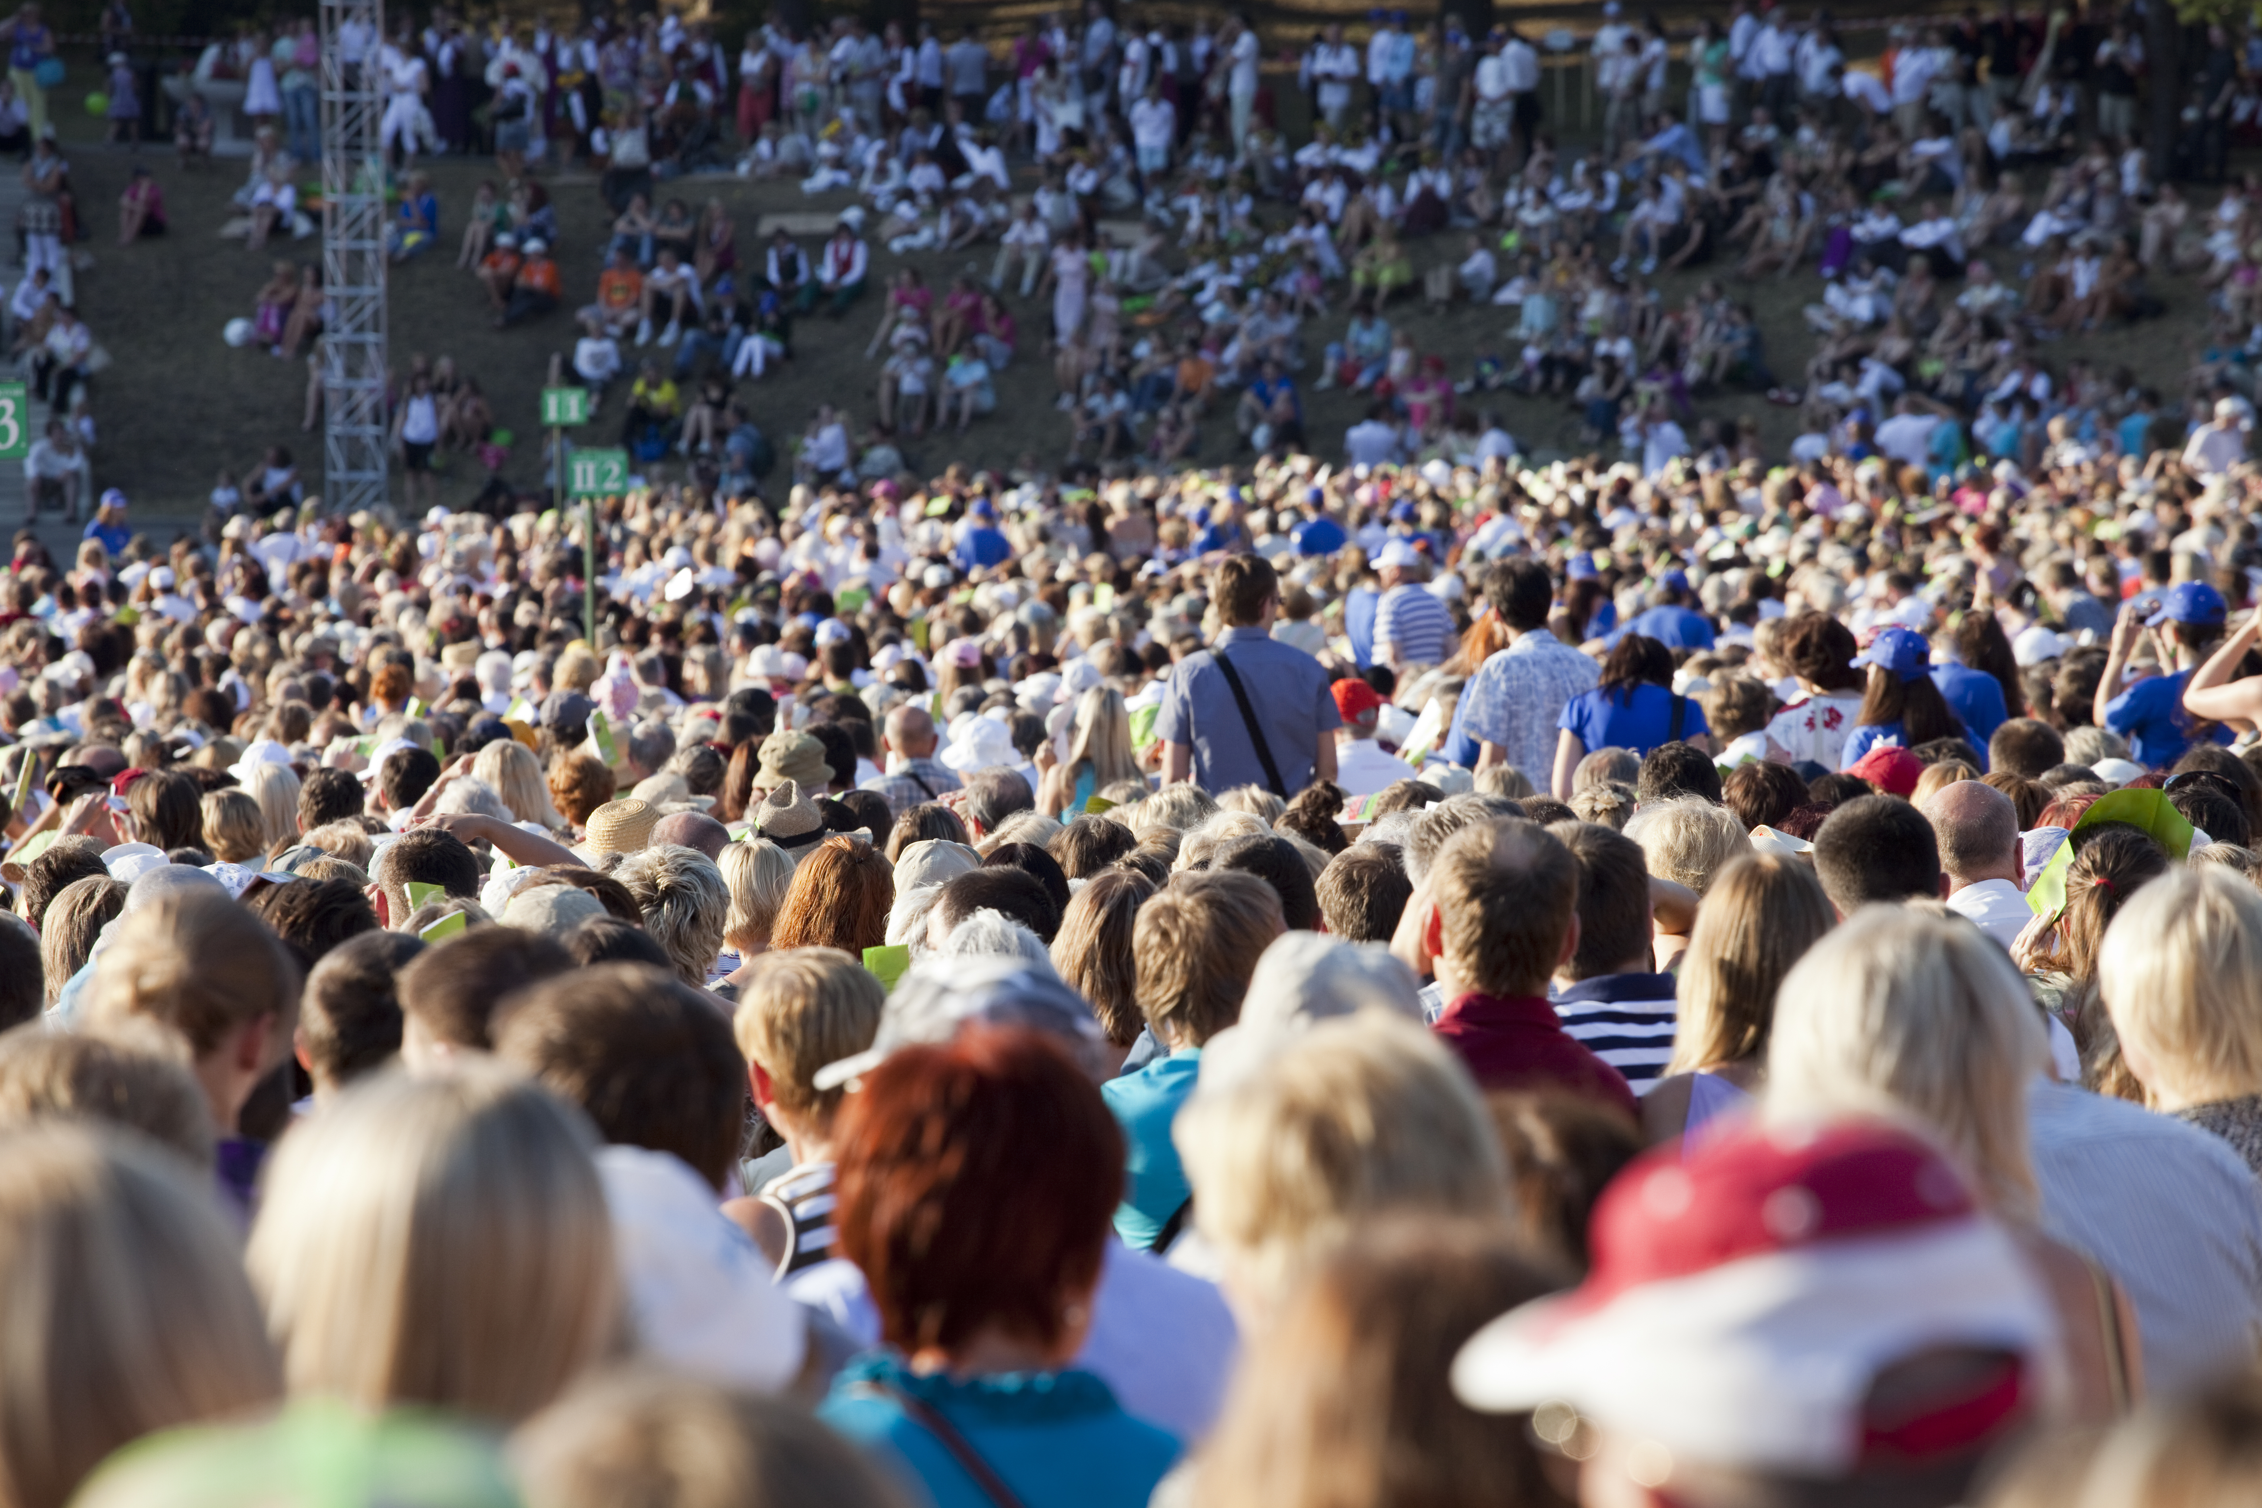
Needs
Audiences
Decision Makers – Management of response and plan execution
Public – Supporting family, neighbors, friends in responding
Emergency Responders – Prioritizing response and effectively responding
Etc.
Image Credit: Shutterstock
Notes:
Maximize availability of information while protecting confidentiality and privacy.

Slide 4
Needs
Information
Emergency Response Requests
Guidance to Public
Status of Critical Infrastructure
Capacity of Support Facilities
Availability of Resources
Forecast and Current Conditions
Image Credit: Reliefweb
Notes:
Focus first on information needs, then on data that can satisfy those needs

Slide 5
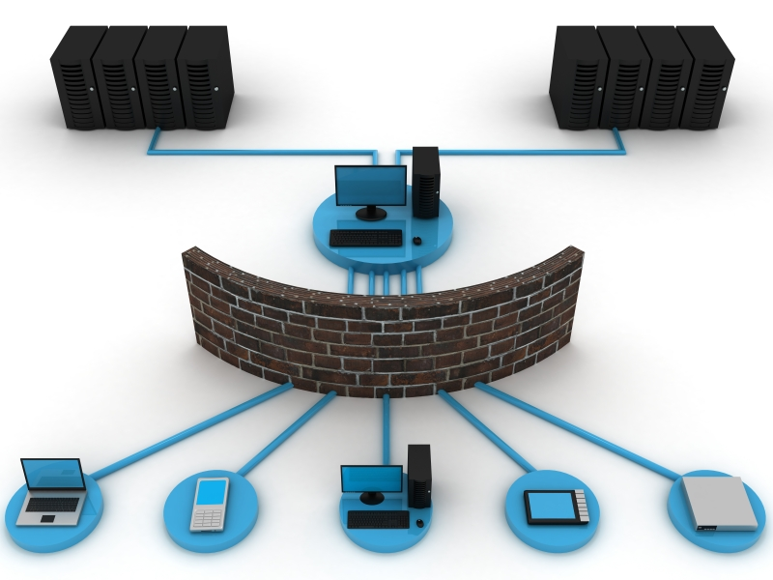
Needs
Information Delivery Systems
Desktop computers
Applications (e.g. GIS, web applications, statistical models)
Mobile Devices (apps, web based, messages)
Large-scale Displays/Alerts
Printed Materials
Image Credit: iStockphoto
Notes:
How can information and the data related to that information be efficiently delivered into diverse platforms

Slide 6

Needs
Data
Emergency Service Requests
Location and Severity of Infrastructure Damage
Areas at Risk for Further Impact
Locations and Types of Resources
Current and Forecast Conditions
Image Credit: Shutterstock
Notes:
Environmental Data
Infrastructure
Built environment
Socioeconomic data
Flows of resources/people
Public health information
Historic (planning & context)
Current (immediate response)
Forecast (planning)

Slide 7

Preparation
Meet Needs
Provide Appropriate Access
Deliver to Diverse Platforms & Applications
Information/Access
Standards-based - interoperable
Data
Workflows for maintaining current and new data
Secure/scalable data storage
Robust Documentation
Image Credit: iStocphoto
Notes:
Public-Private data sharing workflows
Robust data management and access systems that are resilient in the face of disruption of connectivity/capacity
Adoption and sharing of selected format and service standards
Build business rules in to core of system for access control

Slide 8

Outcomes
Data Based Planning & Response
Rapid Access to Current and Forecast Information
Reusable Information for Multiple Audiences & Purposes
Image Credit: Shutterstock

Slide 9

Strategy
Iterate Towards Increased Capacity & Functionality
Image Credit: Dafne Cholet. "Calendar*"
Notes:
Incremental creation of value …
Keeping big picture in mind as new capacity for data use is developed…

Slide 10
Acknowledgements
We acknowledge the use of imagery provided by services from the Global Imagery Browse Services (GIBS), operated by the NASA/Goddard Space Flight Center Earth Science Data and Information System (ESDIS) project.
Additional Imagery From:
Reliefweb - https://reliefweb.int/
Shutterstock
iStockphoto
Dafne Cholet. "Calendar*" https://flic.kr/p/9bUbH3 . https://creativecommons.org/licenses/by/2.0/

